Slide 1
“Exacting A Usury”
Allan Lebak
September 13th 2015

Slide 2
Reintroduction of Myself

Slide 3
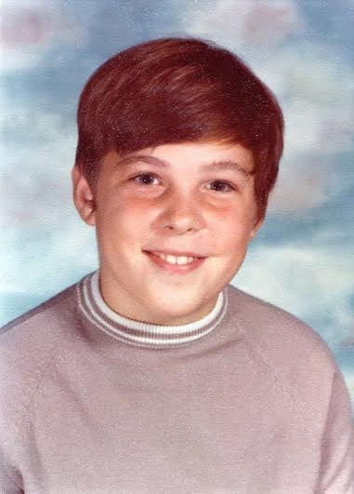
September 1972

Slide 4
Modus Operandi
Means “way of operating” or
“method of operation”

Slide 5
What does “Exacting a Usury” mean?
Dictionary .com definition of Exacting:
1. rigid or severe in demands or requirements: an exacting teacher.
2. requiring close application or attention: an exacting task.
3. given to or characterized by exaction; extortionate

Slide 6
Dictionary.com definition of Usury:
1. the lending or practice of lending money at an exorbitant interest.
2. an exorbitant amount or rate of interest, especially in excess of the legal rate.
3. Obsolete. interest paid for the use of money

Slide 7
Now let’s take a look at some scriptural references (English Standard Version)
Exodus 22: 25
“If you lend money to any of my people with you who is poor, you shall not be like a moneylender to him, and you shall not exact interest from him.”

Slide 8
Leviticus 25: 36-37
“³⁶ Take no interest from him or profit, but fear your God, that your brother may live beside you. ³⁷ You shall not lend him your money at interest, nor give him your food for profit.”
Deuteronomy 23: 19-20
“You shall not charge interest on loans to your brother, interest on money, interest on food, interest on anything that is lent for interest. ²⁰ You may charge a foreigner interest, but you may not charge your brother interest, that the Lord your God may bless you in all that you undertake in the land that you are entering to take possession of it.”

Slide 9
Proverbs 28: 8
“Whoever multiplies his wealth by interest and profit gathers it for him who is generous to the poor.”
Nehemiah 5: 1-13
“Now there arose a great outcry of the people and of their wives against their Jewish brothers. ² For there were those who said, “With our sons and our daughters, we are many. So let us get grain, that we may eat and keep alive.” ³ There were also those who said, “We are mortgaging our fields, our vineyards, and our houses to get grain because of the famine.” ⁴ And there were those who said, “We have borrowed money for the king's tax on our fields and our vineyards. -

Slide 10
Nehemiah 5: 1-13 (cont.)
“⁵ Now our flesh is as the flesh of our brothers, our children are as their children. Yet we are forcing our sons and our daughters to be slaves, and some of our daughters have already been enslaved, but it is not in our power to help it, for other men have our fields and our vineyards. ⁶ I was very angry when I heard their outcry and these words. ⁷ I took counsel with myself, and I brought charges against the nobles and the officials. I said to them, “You are exacting interest, each from his brother.” And I held a great assembly against them ⁸ and said to them, “We, as far as we are able, have bought back our Jewish brothers who have been sold to the nations, but you even sell your brothers that they may be sold to us!” They were silent and could not find a word to say. ⁹ So I said, “The thing that you are doing is not good. Ought you not to walk in the fear of our God to prevent the taunts of the nations our enemies? ¹⁰ Moreover, I and my brothers and my servants are lending them money and grain. Let us abandon this exacting of interest.”

Slide 11
Nehemiah 5: 1-13 (cont.)
¹¹ Return to them this very day their fields, their vineyards, their olive orchards, and their houses, and the percentage of money, grain, wine, and oil that you have been exacting from them.” ¹² Then they said, “We will restore these and require nothing from them. We will do as you say.” And I called the priests and made them swear to do as they had promised. ¹³ I also shook out the fold of my garment and said, “So may God shake out every man from his house and from his labor who does not keep this promise. So may he be shaken out and emptied.” And all the assembly said “Amen” and praised the Lord. And the people did as they had promised.”

Slide 12
Why was usury a problem?
Mosaic Law- Given to Moses on Mt. Sinai
Brothers were not supposed to charge other brothers interest.
Especially not usury – (excessive interest)
This was not only in direct defiance of the law given to Moses, but it is also shameful.
They were all Jewish brothers and sisters related to Father God
He wanted something much better for his people

Slide 13
Let’s apply this in a different context
Usury can apply to things other than money
God , People , Ministry

Slide 14
God
Psalm 139: 13-16
¹³ For you created my inmost being; you knit me together in my mother’s womb. ¹⁴ I praise you because I am fearfully and wonderfully made; your works are wonderful, I know that full well. ¹⁵ My frame was not hidden from you when I was made in the secret place, when I was woven together in the depths of the earth. ¹⁶ Your eyes saw my unformed body; all the days ordained for me were written in your book before one of them came to be.

Slide 15
We think that we’re so smart and slick
Making deals with God
Matthew 7: 9-11
⁹ “Which of you, if your son asks for bread, will give him a stone? ¹⁰ Or if he asks for a fish, will give him a snake? ¹¹ If you, then, though you are evil, know how to give good gifts to your children, how much more will your Father in heaven give good gifts to those who ask him!”
There is a difference between USING God and ASKING God
Just be real!

Slide 16
People
Using other people to get what you want
Spouses - physical and emotional usury
Family and Friends- Do you “love” and “appreciate” people so that you can get what you want?

Slide 17
Ministry
Setting unreasonably high expectations on leadership
Is being part of a congregation about giving or taking?
It’s not a question of getting involved or not but rather what can I get involved in
How can I best serve the body of Christ

Slide 18
In Closing
Prayer of Repentance
Prayer of Healing

