Slide 1
Christmas Everyday
Allan Lebak
12/13/15

Slide 2
I intend to cover the roots and origins of what is now celebrated as Christmas.

Slide 3
What I remember about Christmas
Church
Movies (Charlie Brown Christmas, Chitty Chitty Bang Bang)
Sears Christmas Catalog
Finding the perfect tree (Discount Tree)
Setting up the tree (Coal Bucket)
Decorating the tree

Slide 4
“Is this what Christmas is all about?” -Charlie Brown
Commercialism
Busyness
Focus On Gifts
Hallmark Movies Mrs. Miracle, Crown For Christmas, Tis the Season For Love, Ice Sculpture Christmas, Christmas Incorporated

Slide 5
Now a history lesson…
Saturnalia- Roman festival 200 years before Christ/17th-25th of December.
Lawless Festival- Hedonism
Lord of Misrule- Murdered as a sacrifice to Saturn

Slide 6
In the 4th century the Catholic church, wanting to make converts, told the Pagans if they converted to Catholicism they could continue to practice Saturnalia.

Slide 7
Trouble was there was nothing “Christian” about Saturnalia, so the Catholic church decided to celebrate Jesus’s birthday on the last day of the festival; December 25th.

Slide 8
The amount of information about Christmas origins is staggering because there are so many side branches.
Julian vs Gregorian calendars
Various customs in different areas
Pagan rituals
-Evergreens
-Mistletoe
-Gift Giving
-Santa- around 325 AD
-There was actually a Nicolas cult
-Catholic Church adopted Nicholas
-Decided to give gifts on 25th December

Slide 9
Is this what Christmas is all about? No Charlie Brown.

Slide 10
Then what is it about exactly?

Slide 11
Luke 19:10 “For the Son of Man came to seek and to save the lost.” Matthew 20:28 “Just as the Son of Man did not come to be served, but to serve, and to give his life as a ransom for many.” 1 John 4:10 “This is love: not that we loved God, but that he loved us and sent his Son as an atoning sacrifice for our sins.”
It’s about redemption.

Slide 12
God desires us to be close to Him; to know Him.
From the beginning, God knew we would sin and we would need a way to be reunited with our Father.
(1 Peter 1:20) “He was chosen before the creation of the world, but was revealed in these last times for your sake.”
Jesus’s birth, death, and resurrection was the plan God had in mind to redeem us.
He came for you personally; If it was only you He still would have come.

Slide 13
Jesus was called the 2nd Adam
Adam was created from the dust- no earthly DNA
Jesus too had no earthly DNA and was created sinless

Slide 14
This reminds me of the song lyrics: “Behold what manner of love the Father has given unto us, that we should be called the sons of God.”

Slide 15
The “Manner of Love” that the song speaks of is Jesus being born, dwelling among us, dying for our sins, and being resurrected to the throne of God.

Slide 16
Every morning His mercy’s are new. (Lamentations 3)
So the “Christmas” that we can celebrate everyday is rejoicing in the plan that Father God always had in mind for us

Slide 17
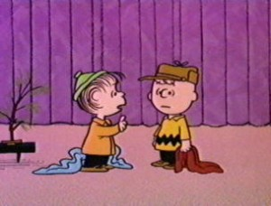
That’s what Christmas is about Charlie Brown.

Slide 18
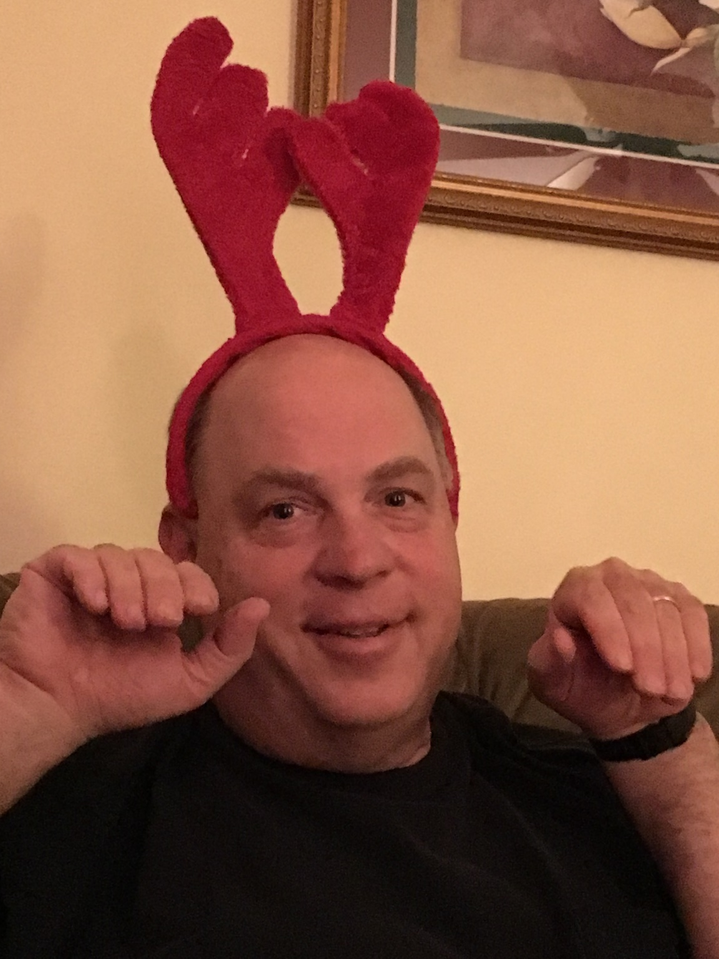
Merry Christmas
Everyone!
The Lebak family

