Slide 1
“This is My Commandment”
Allan Lebak 5/22/2016

Slide 2
What is a commandment?
Why are they important?
What does it mean for me?

Slide 3
What is a commandment?
A rule that must be obeyed, especially one handed down by God
An authoritative direction or order

Slide 4
The word commandment appears 177 times in the Bible – (King James version)
Most of us just think of the “Ten” Commandments
All of them direct us to follow God and walk in his instructions

Slide 6
Notice that they are not called
The ten “suggestions”
The ten “good ideas”
The ten “if you feel like its”

Slide 7
Deuteronomy 4: 5-14
⁵ See, I have taught you decrees and laws as the Lord my God commanded me, so that you may follow them in the land you are entering to take possession of it. ⁶ Observe them carefully, for this will show your wisdom and understanding to the nations, who will hear about all these decrees and say, “Surely this great nation is a wise and understanding people.” ⁷ What other nation is so great as to have their gods near them the way the Lord our God is near us whenever we pray to him? ⁸ And what other nation is so great as to have such righteous decrees and laws as this body of laws I am setting before you today?
⁹ Only be careful, and watch yourselves closely so that you do not forget the things your eyes have seen or let them fade from your heart as long as you live. Teach them to your children and to their children after them.

Slide 8
Deuteronomy 4: 5-14 cont.
¹⁰ Remember the day you stood before the Lord your God at Horeb, when he said to me, “Assemble the people before me to hear my words so that they may learn to revere me as long as they live in the land and may teach them to their children.” ¹¹ You came near and stood at the foot of the mountain while it blazed with fire to the very heavens, with black clouds and deep darkness. ¹² Then the Lord spoke to you out of the fire. You heard the sound of words but saw no form; there was only a voice. ¹³ He declared to you his covenant, the Ten Commandments, which he commanded you to follow and then wrote them on two stone tablets. ¹⁴ And the Lord directed me at that time to teach you the decrees and laws you are to follow in the land that you are crossing the Jordan to possess.

Slide 9
So why is this all so important?
These commands are for our protection and growth.
These commandments cause us to behave in a way that glorifies God
They keep us from self destructive habits

Slide 10
It may seem to us that it’s just a bunch of rules
Beat your rebellious nature with a stick!
Rules only produce a religion
Instruction given in love produces a relationship

Slide 11
What does this mean for me?
God desires a relationship with us
God desires us to relate with one another
God desires us to love each other as He loves us

Slide 12
John15: 9-17 (NKJV)
⁹ “As the Father loved Me, I also have loved you; abide in My love. ¹⁰ If you keep My commandments, you will abide in My love, just as I have kept My Father’s commandments and abide in His love.
¹¹ “These things I have spoken to you, that My joy may remain in you, and that your joy may be full. ¹² This is My commandment, that you love one another as I have loved you. ¹³ Greater love has no one than this, than to lay down one’s life for his friends. ¹⁴ You are My friends if you do whatever I command you.

Slide 13
John15: 9-17 (NKJV) cont.
¹⁵ No longer do I call you servants, for a servant does not know what his master is doing; but I have called you friends, for all things that I heard from My Father I have made known to you. ¹⁶ You did not choose Me, but I chose you and appointed you that you should go and bear fruit, and that your fruit should remain, that whatever you ask the Father in My name He may give you. ¹⁷ These things I command you, that you love one another.

Slide 14
So ultimately God’s Commandments are a sign of his unending love toward us
His Commandment is that we love one another as He loved us
Love that is full of direction and wisdom but lacking in judgementalism
Love that is not self seeking, but rather lays down it’s life for another

Slide 15
In closing today, we can understand that God’s Commandments are truly and ultimately a blessing for us to walk in and pass on to future generations.

Slide 16
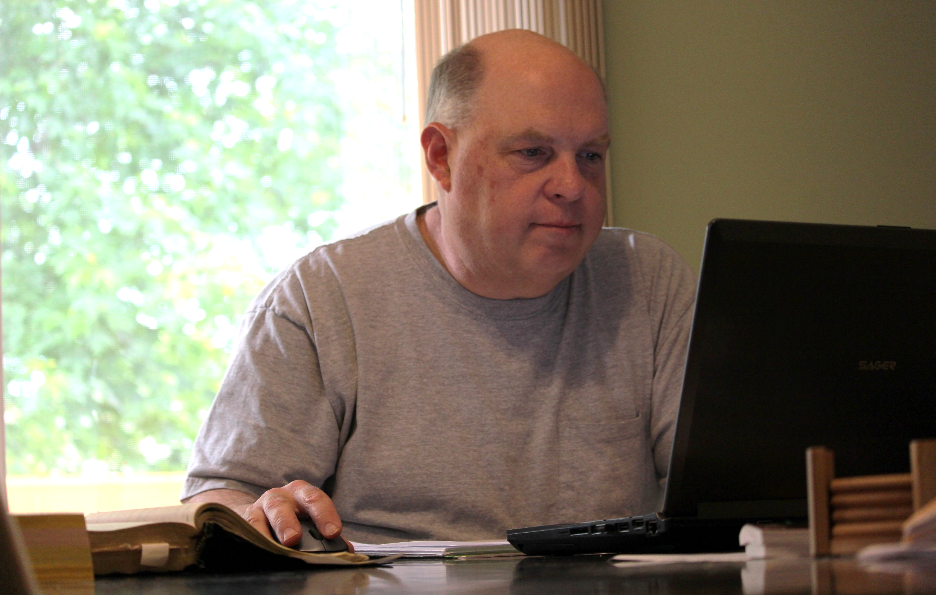
Go Do Something Great Today!

