Slide 1
What manner of man is this?

Slide 2
Luke 8: 22-25

Slide 3
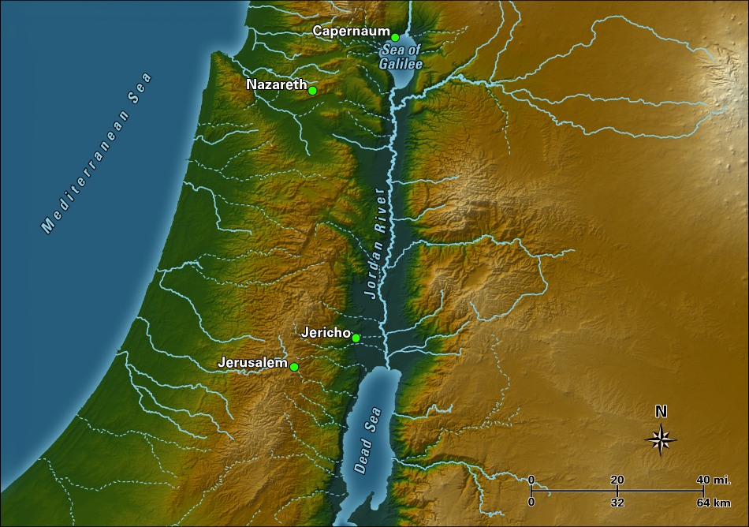

Slide 4
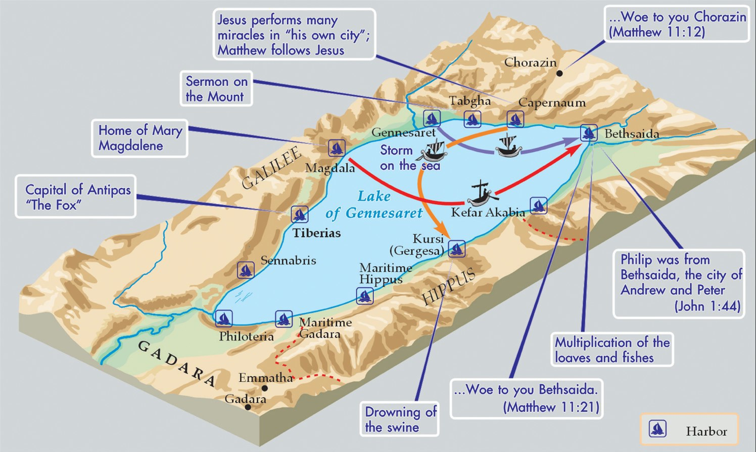

Slide 5
Luke 8:22-25
²² Now it came to pass on a certain day, that he went into a ship with his disciples: and he said unto them, Let us go over unto the other side of the lake. And they launched forth.
²³ But as they sailed he fell asleep: and there came down a storm of wind on the lake; and they were filled with water, and were in jeopardy.
²⁴ And they came to him, and awoke him, saying, Master, master, we perish. Then he arose, and rebuked the wind and the raging of the water: and they ceased, and there was a calm.
²⁵ And he said unto them, Where is your faith? And they being afraid wondered, saying one to another, What manner of man is this! for he commandeth even the winds and water, and they obey him.

Slide 6
WHO is this man?
Living Bible (TLB)

Slide 7
The Message (MSG)
Who is this, anyway?

Slide 9
Luke 8:25 What manner of man is this?

Slide 10
The news spread about him through the whole country side.
Luke 14:14

Slide 11
Deuteronomy 31:8
Living Bible (TLB)
⁸ Don’t be afraid, for the Lord will go before you and will be with you; he will not fail nor forsake you.”

Slide 12
Deuteronomy 31:8
Living Bible (TLB)
⁸ Don’t be afraid, for the Lord will go before you and will be with you; he will not fail nor forsake you.”

Slide 13
Deuteronomy 31:8
Living Bible (TLB)
⁸ Don’t be afraid, for the Lord will go before you and will be with you; he will not fail nor forsake you.”

Slide 14
John 16:33 King James Version (KJV)
³³ These things I have spoken unto you, that in me ye might have peace. In the world ye shall have tribulation: but be of good cheer; I have overcome the world.

Slide 16
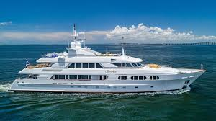

Slide 17
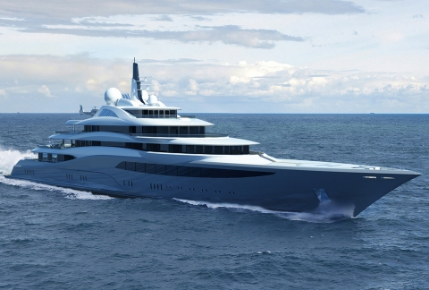

Slide 18
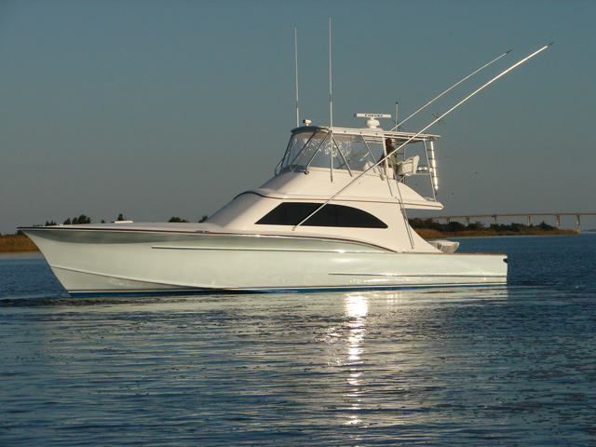

Slide 19
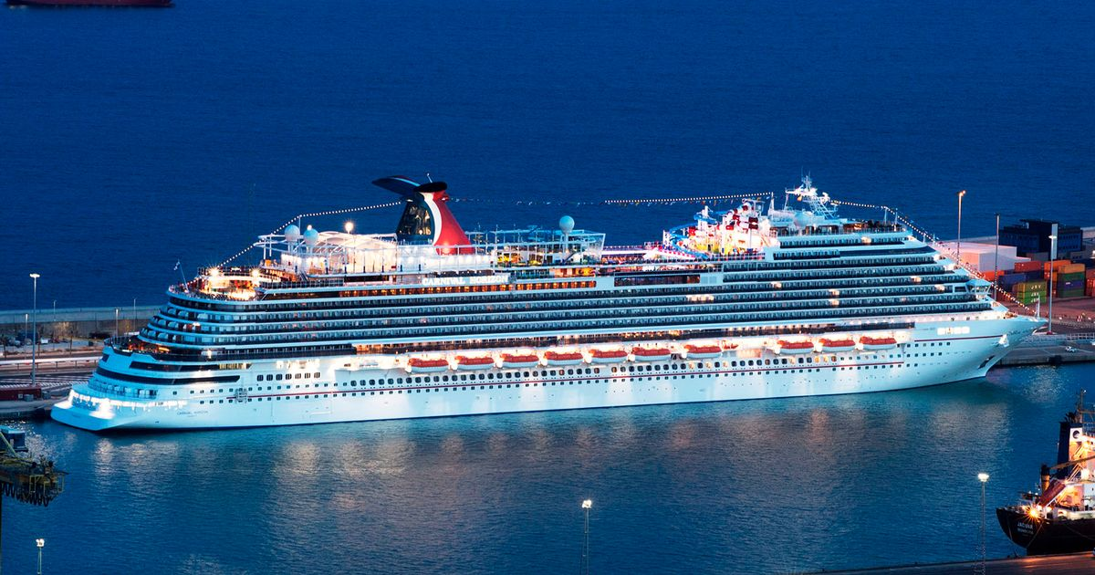

Slide 20
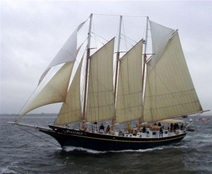

Slide 21
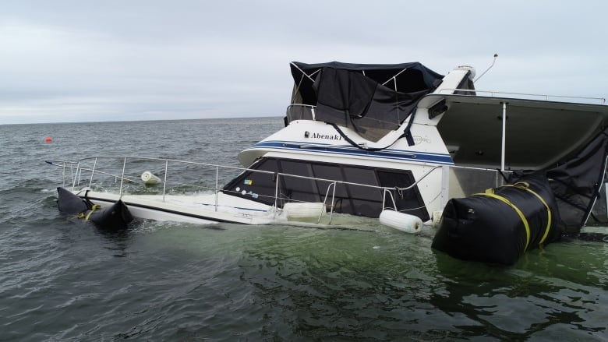

Slide 22
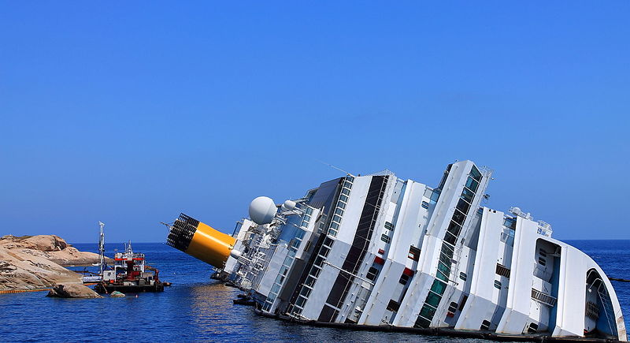

Slide 23
Charles Rossel 1902-1998

Slide 24
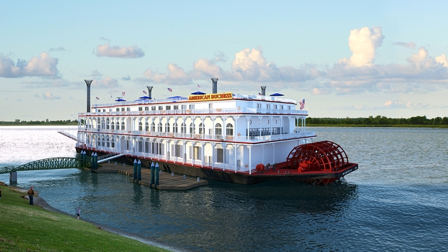

Slide 25
Charles and Margaret Rossel

Slide 26
Deuteronomy 31:8
⁸ Don’t be afraid, for the Lord will go before you and will be with you; he will not fail nor forsake you.”
John 16:33
³³ These things I have spoken unto you, that in me ye might have peace. In the world ye shall have tribulation: but be of good cheer; I have overcome the world.

